Slide 1


MOVIE RECOMMENDATION WITH REVIEW ANALYSIS SYSTEM
PROJECT RED MIMD

Slide 2


Project Guide
Prof. Girijesh Mishra
BBD-ITM
Department of Information Technology
A school project
presented by Group 3
24th May, 2021

Slide 3
Presentation Overview
02
Introduction
Main Objective
Project Analysis
Requirements and Specifications
Data Analysis
Technical Aspects
Conclusion
KEY TOPICS
Project Red Mind

Slide 4

Introduction
03
WHAT IS MOVIE REVIEW SYSTEM?
This is to computerize and recommend movies based on genre preferences that are user-friendly, simple, fast, and cost-effective.

Slide 5

Traditionally, it was done by critics and the choices of users weren’t taken into account. Here we propose an online system that automatically allows users to post reviews and stores them to rate movies based on user sentiments.
04
These ratings are provided as input to the website rating system. The admin then checks reviews, critic’s ratings and displays an online rating for every movie. The main function of the system is to register and store movie details and retrieve these details.
Project Red Mind
Our system now analyzes this data to check for user sentiments associated with each comment. The system breaks user comments to check for sentimental keywords and predicts user sentiment associated with it.

Slide 6







Main Objective
05
Information about every released movie & storing User details.
Generating user review system.
Storing critic and user review data in the database.
Recommend movies according to specific user preferences.
Display review and rating information of a particular movie chosen by any user.
Give user access to give review or comment on a movie.

Slide 7
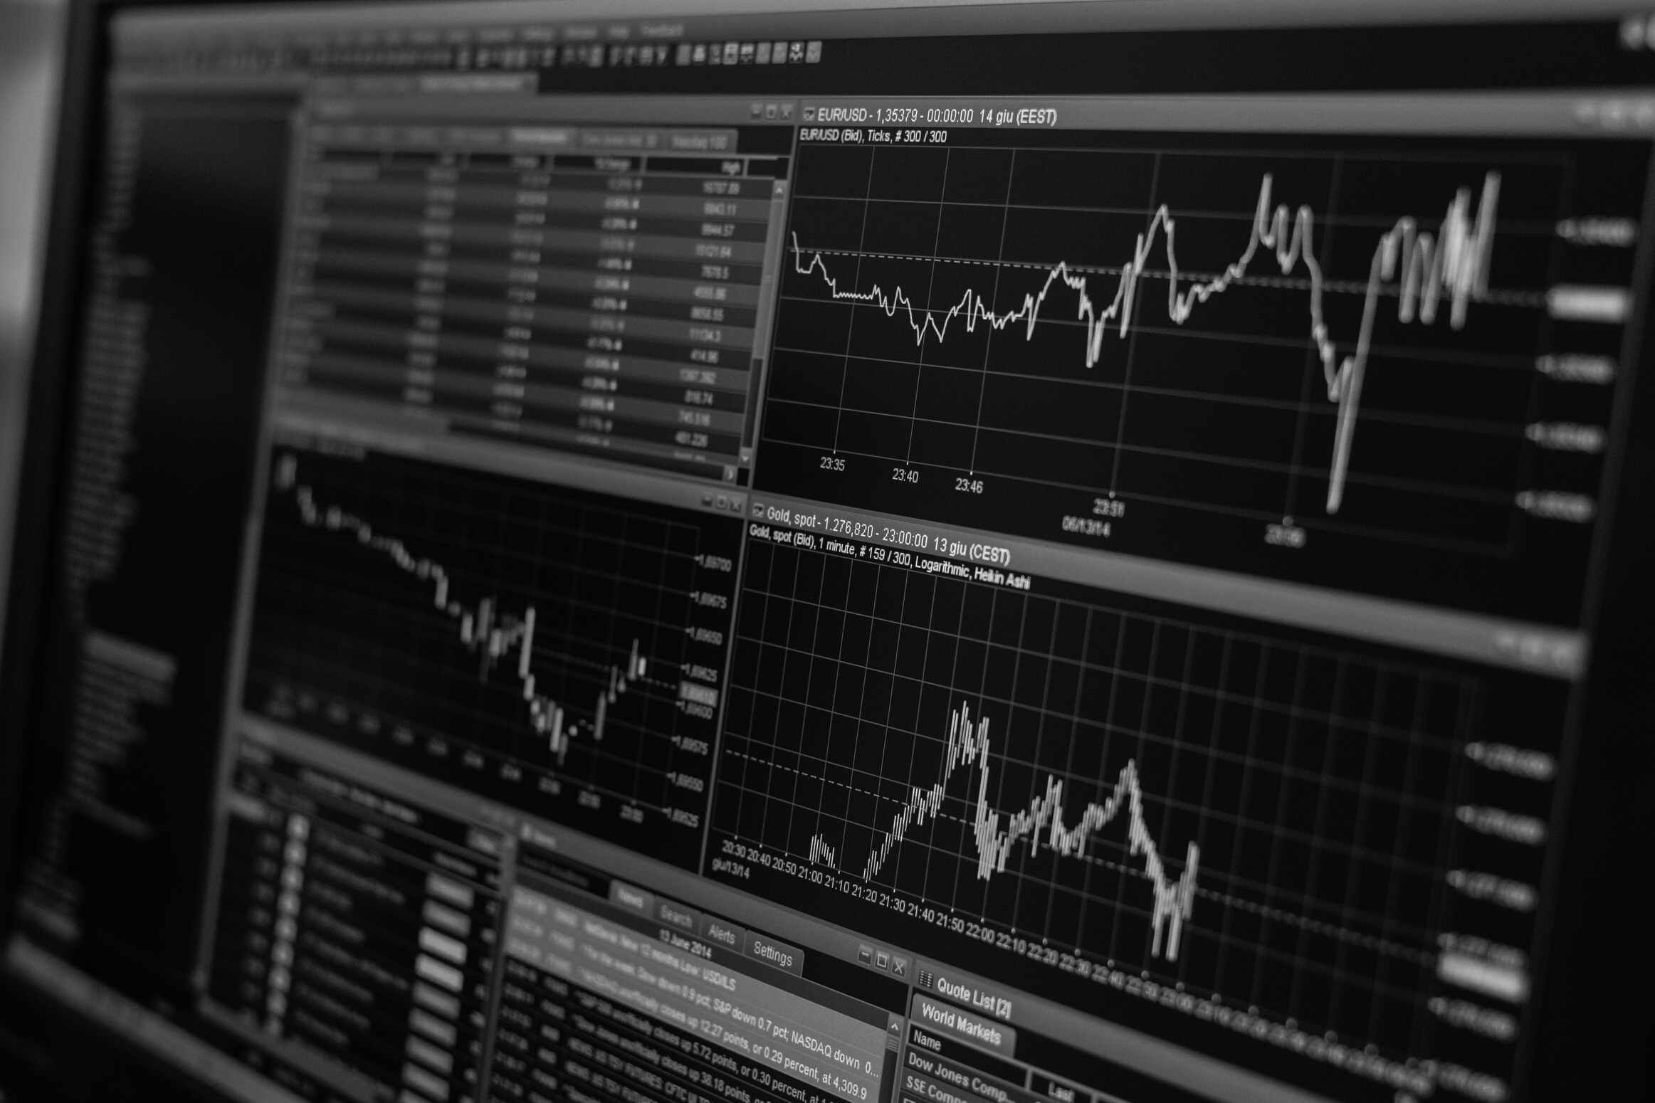

PROJECT ANALYSIS
06
The entire project mainly consists of 3 modules, which are:
Admin module
User module (Registration)
Movie Review Module
Project Red Mind
System Design

Slide 8
Admin Module
Project Red Mind
DASHBOARD
MOVIES
USERS
In this section, the admin can view the total number of users, movies according to years and their genres.
In this section, the admin can add any movie specialization and manage according to requirement. (Add/Update).
In this section, the admin can view users' details and also have the right to delete irrelevant users

Slide 9
Admin Module
Project Red Mind
CONTACT US
USER SESSION LOGS
In this section, the admin can view queries that are sent by the users.
In this section, the admin can see the login and logout times of the user.

Slide 10
09
DASHBOARD
In this section, users can view their profile, and previously watched movies.
User Module
(Registration)
User can update their profile, change the password and recover their password.
They can see their favorites and saved movies.

Slide 11
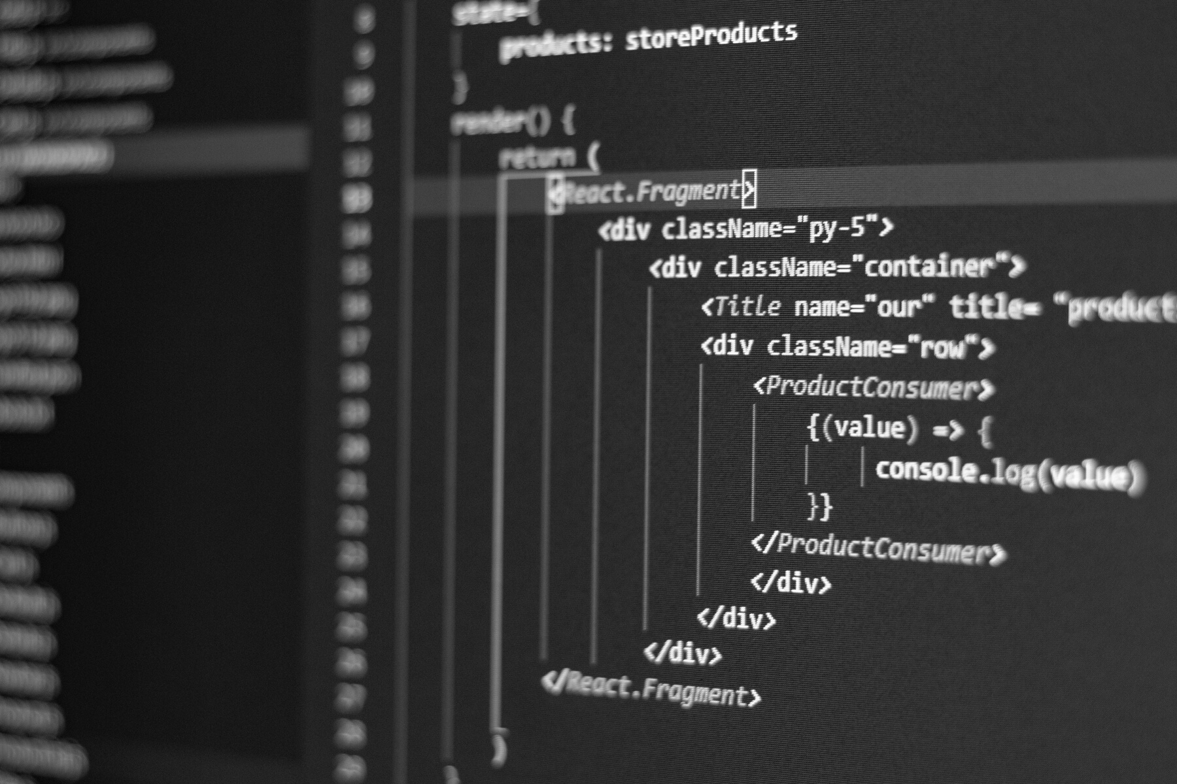
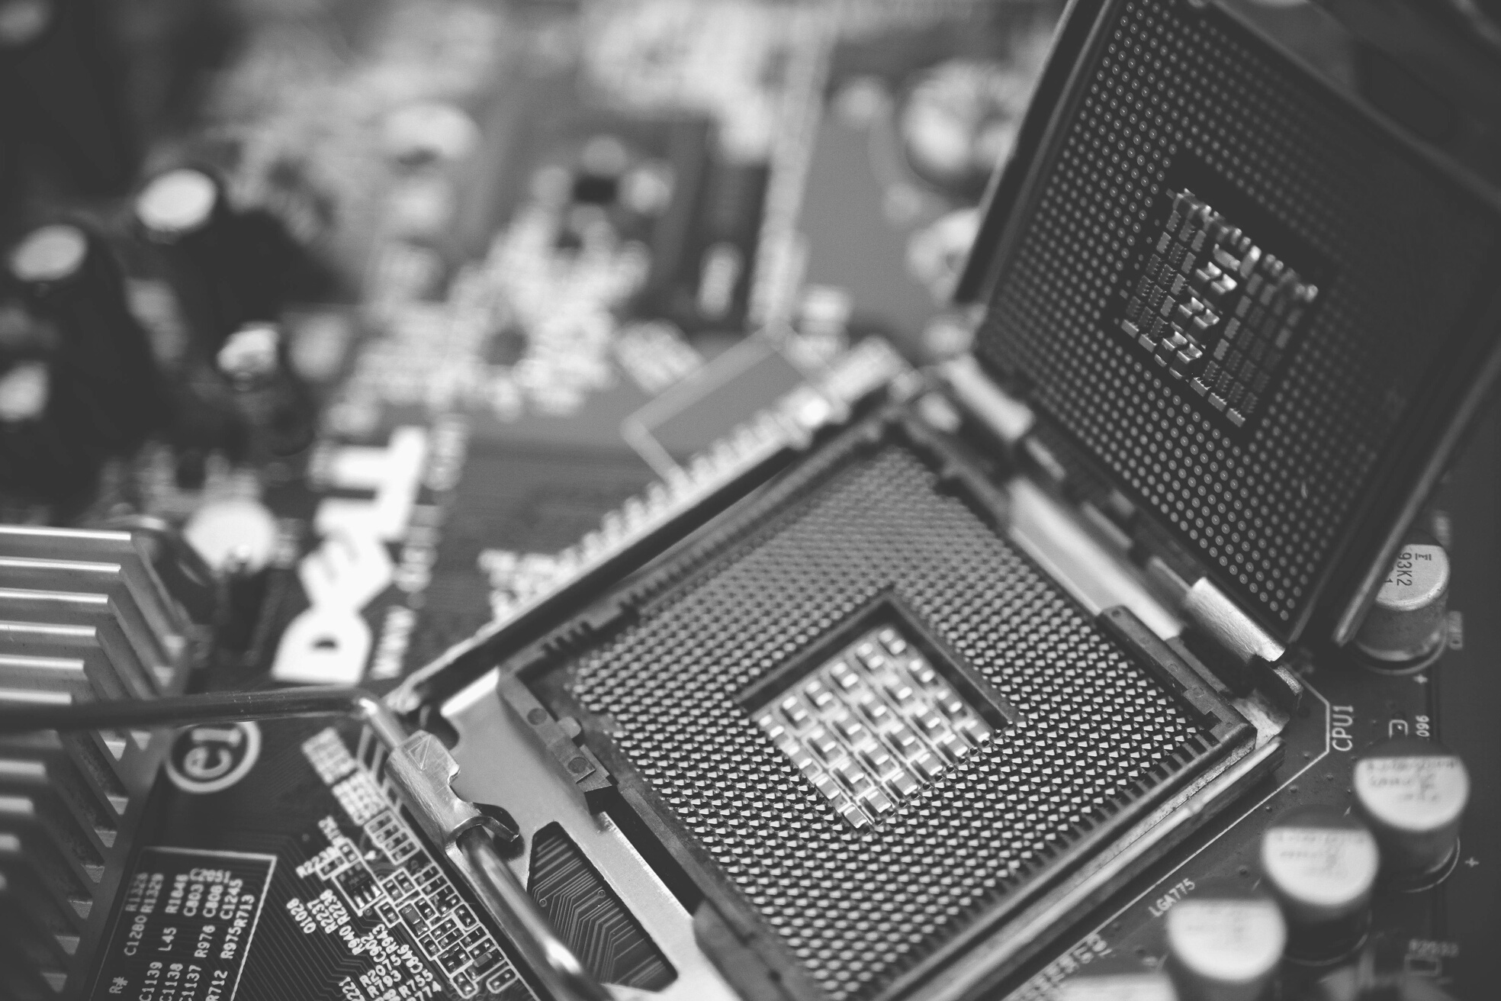
10
REQUIREMENTS AND SPECIFICATIONS
Requirements and specifications are known as (computer) system requirements and are often used as a guideline as opposed to an absolute rule. Most software defines two sets of system requirements: minimum and recommended.

Slide 12
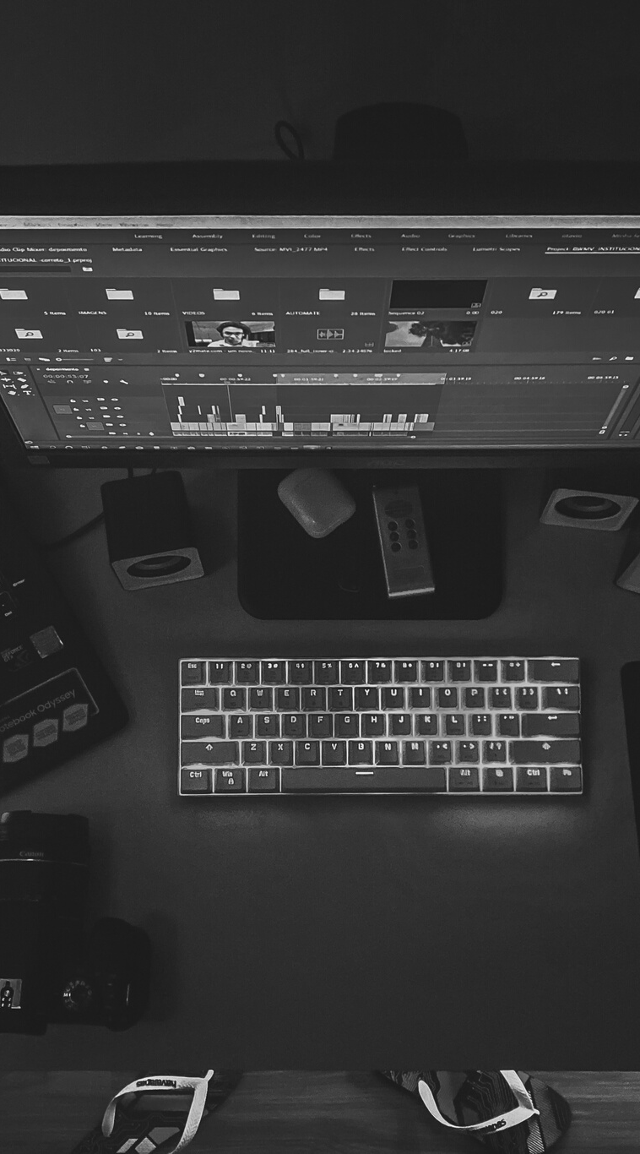
The most common set of requirements defined by any operating system or software application is the physical computer resources, also known as hardware. A hardware requirements list is often accompanied by a hardware compatibility list (HCL), especially in the case of operating systems. An HCL lists tested, compatibility, and sometimes incompatible hardware devices for a particular operating system or application.
Software Requirements deal with defining software resource requirements and prerequisites that need to be installed on a computer to provide optimal functioning of an application. These requirements or pre-requisites are generally not included in the software installation package and need to be installed separately before the software is installed.

Slide 13
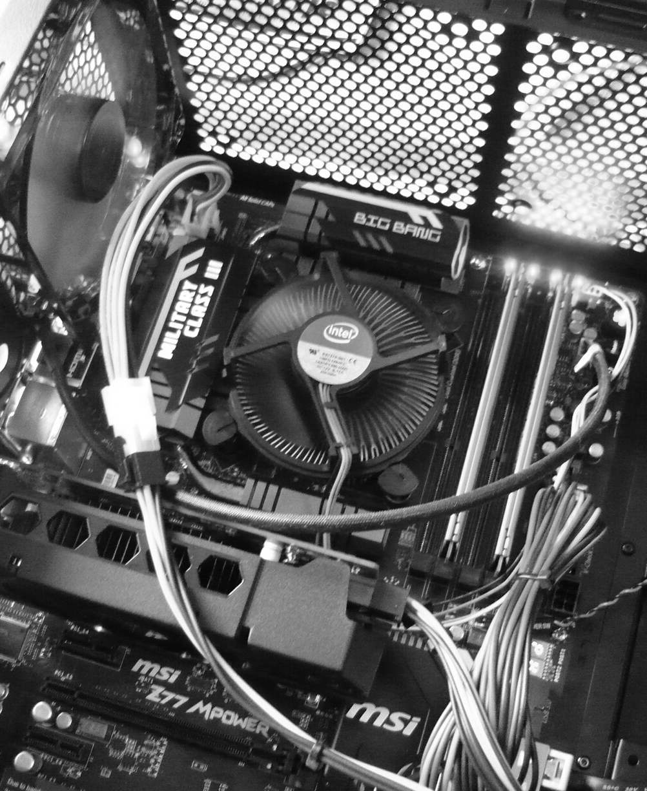
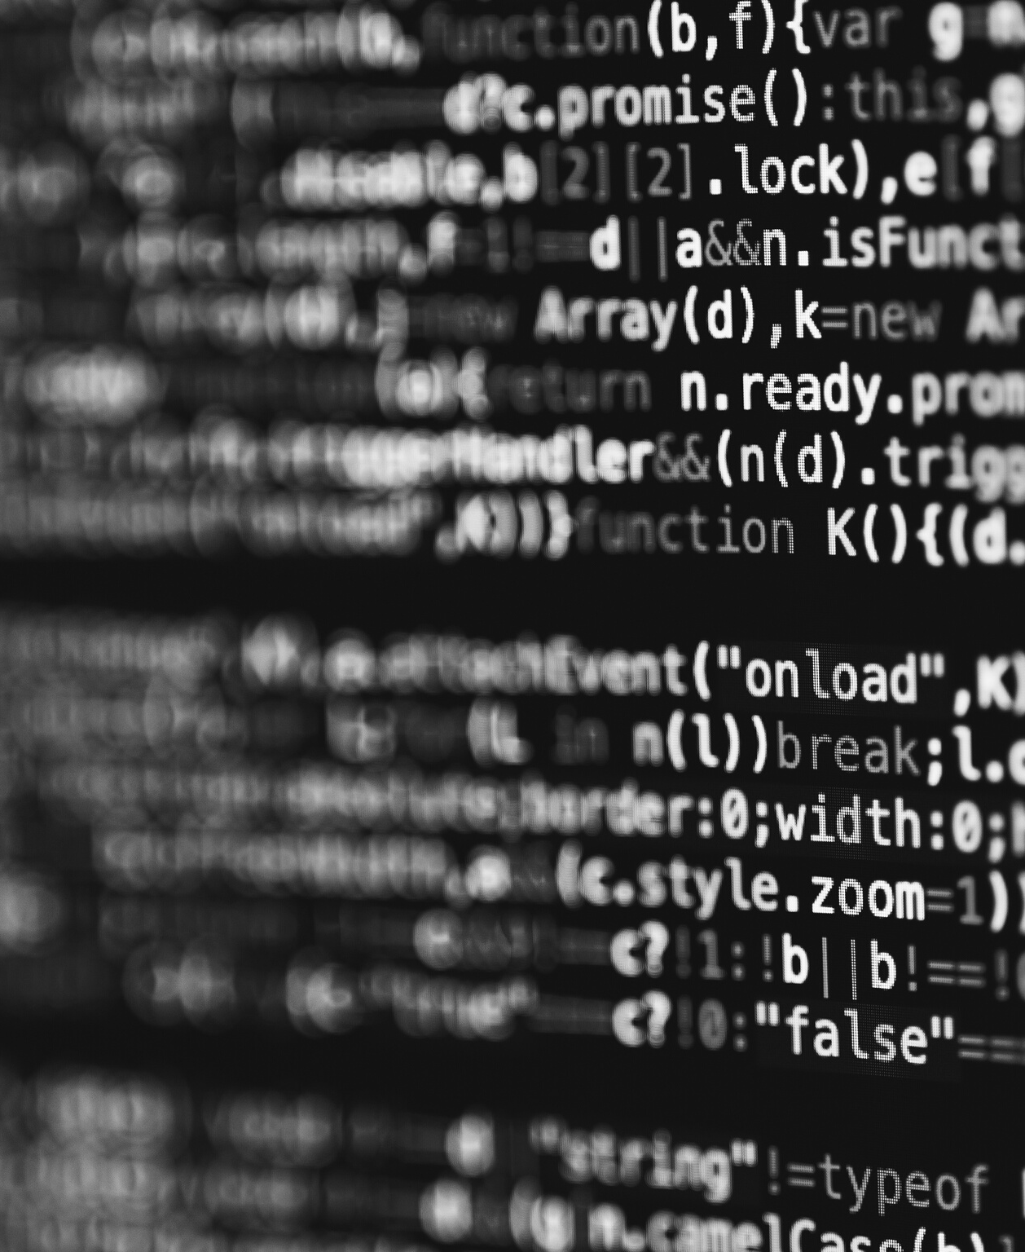
12
Hardware
Software
OPERATING SYSTEM: WINDOWS 7/ XP/8/10
FRONT END:
HTML, CSS,JavaScript,Bootstrap
BACK END: Python, Django
SERVER: Apache Tomcat Server
databaSE: SQLite3
PROCESSOR: INTEL DUAL CORE, I3
RAM: 1 GB
HARD DISK: 80 GB
Project Red Mind

Slide 14
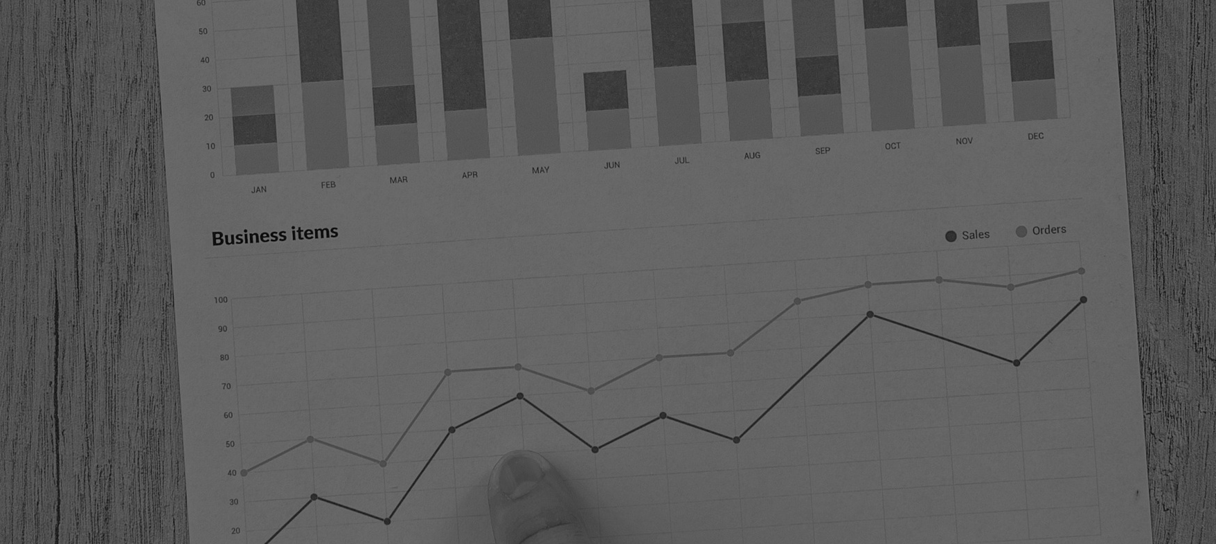
13
DATA ANALYSIS
Project Red Mind

Slide 15

Data Collection
14
To collect movie data here we are using web scraping and Web API. For collecting the data of Bollywood movies we are using python modules such as to request, urllib, Beautifulsoup, etc. And for collecting the data of Hollywood movies we are using the TMDB API.

Slide 16

Data Preprocessing
15
After collecting the data we apply some data preprocessing to prepare the relevant dataset for creating the machine learning model.

Slide 17
16
The data in the system has to be stored and retrieved from the database.
Data elements and data structures to be stored have been identified at the analysis stage. They are structured and put together to design the data storage and retrieval system.
Database Design
Project Red Mind

Slide 18
18
Normalization is done to get an internal consistency of data and to have minimum redundancy and maximum stability. This ensures minimizing data storage required, minimizing chances of data inconsistencies, and optimizing for updates.
Project Red Mind
For example, it is easy to find all users who have seen a certain movie or find the movies that two users have both seen. This flexibility led us to create an SQLite, the schema is shown below:

Slide 19
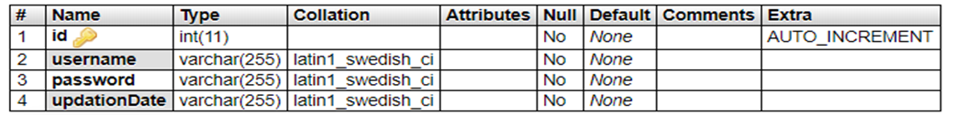
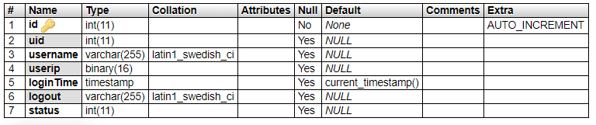
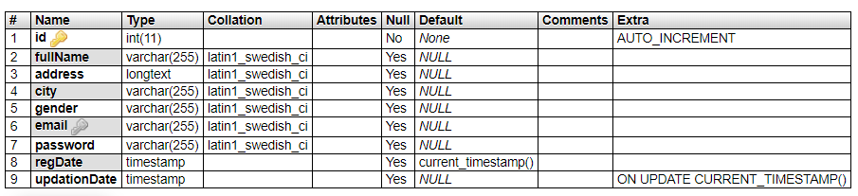
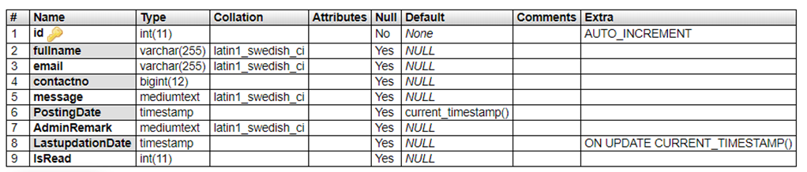
ADMIN TABLE STRUCTURE: THIS TABLE STORE THE LOGIN DETAILS OF ADMIN.
USER LOG TABLE STRUCTURE: THIS TABLE STORE THE USER’S LOGIN AND PERSONAL DETAILS.
USERS TABLE STRUCTURE: THIS TABLE STORE THE USER’S LOGIN AND PERSONAL DETAILS.
CONTACTUS TABLE STRUCTURE: THIS TABLE STORE THE CONTACT US QUERY DETAILS .

Slide 20

19
TECHNICAL ASPECTS
Project Red Mind

Slide 21
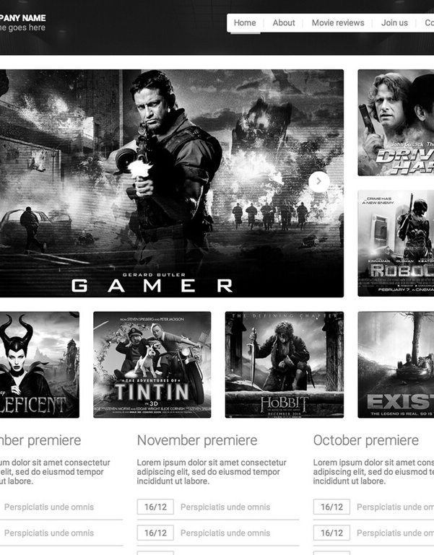
Frontend
20
The website is primarily designed using HTML as its base and for styling, we have used cascading style sheets (CSS), furthermore to give it a dynamic approach we have integrated javascript with it. It gives an interactive show to the user making them more engaged.
To make the code less bulky jquery is used to wrap texts and call them with a single line of code. Bootstrap makes the site more efficient and responsive by creating better UI/UX templates.
Wallace Design Inc.

Slide 22
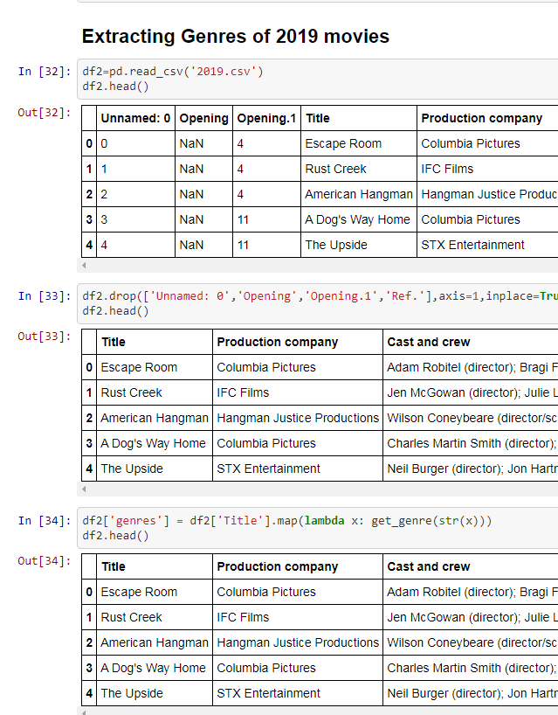
Backend
21
In this project, we are using the Django Web Framework. Django is a high-level Python Web framework that encourages rapid development and clean, pragmatic design. It takes care of much of the hassle of Web development, so you can focus on writing your app without needing to reinvent the wheel.
And the database part of this project is implemented using SQLite. SQLite helps to interact with relational databases. SQLite is stored as a single file. This makes sharing databases easier. By default, Django uses the SQLite database.
Wallace Design Inc.

Slide 23
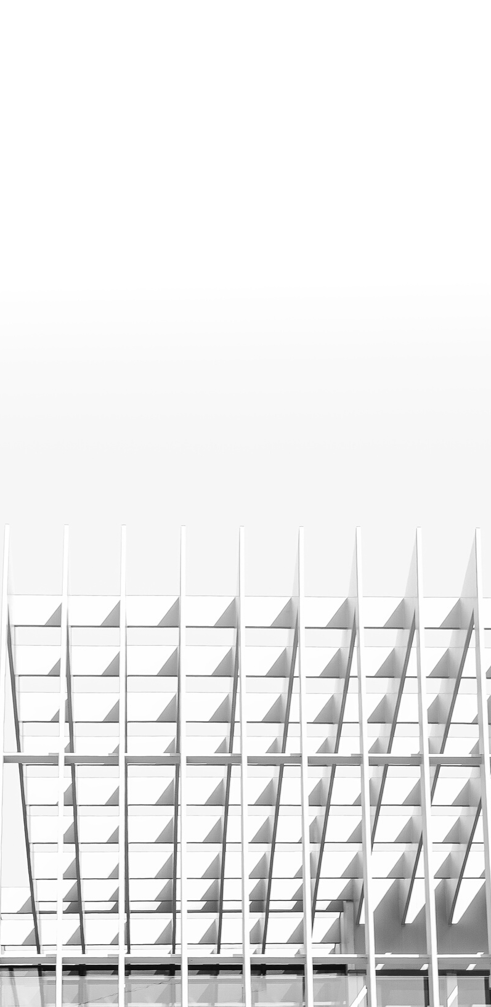
Conclusion
22
This solution is carefully analyzed and after the evaluation of the possible solutions, the most feasible solution for this project is identified and selected, so the project turns to be cost-effective, vital, and practical. Thus processing information will be faster. It guarantees accurate maintenance of details. It easily reduces the bookkeeping task and thus reduces the human effort and increases accuracy speed.

Slide 24
Collecting Bollywood data- https://github.com/IntegratedMindHeart/data_collection/blob/main/movie%20recommendation%20system/wikipedia/bollywood/wikipedia_data_collection.ipynb
Collected Data https://github.com/IntegratedMindHeart/data_collection/blob/main/movie%20recommendation%20system/wikipedia/bollywood/2020.csv
For collecting Hollywood data-
https://github.com/IntegratedMindHeart/data_collection/blob/main/movie%20recommendation%20system/wikipedia/hollywood/wikipedia_data_collection.ipynb
GitHub Repository Links For:
collected data- https://github.com/IntegratedMindHeart/data_collection/blob/main/movie%20recommendation%20system/wikipedia/hollywood/2019.csv
Final scraped data- https://github.com/IntegratedMindHeart/data_collection/blob/main/movie%20recommendation%20system/wikipedia/hollywood/2018_and_2019_final.csv
Data Preprocessing GitHub Repository Link - https://github.com/IntegratedMindHeart/ml_model
GITHUB LINK FOR FRONTEND CODE -
https://github.com/IntegratedMindHeart/project_red_mind/tree/main/front_end
GITHUB LINK FOR BACKEND CODE-
https://github.com/IntegratedMindHeart/project_red_mind/tree/main/red_mind
Our GitHub Organization Link - https://github.com/IntegratedMindHeart

Slide 25
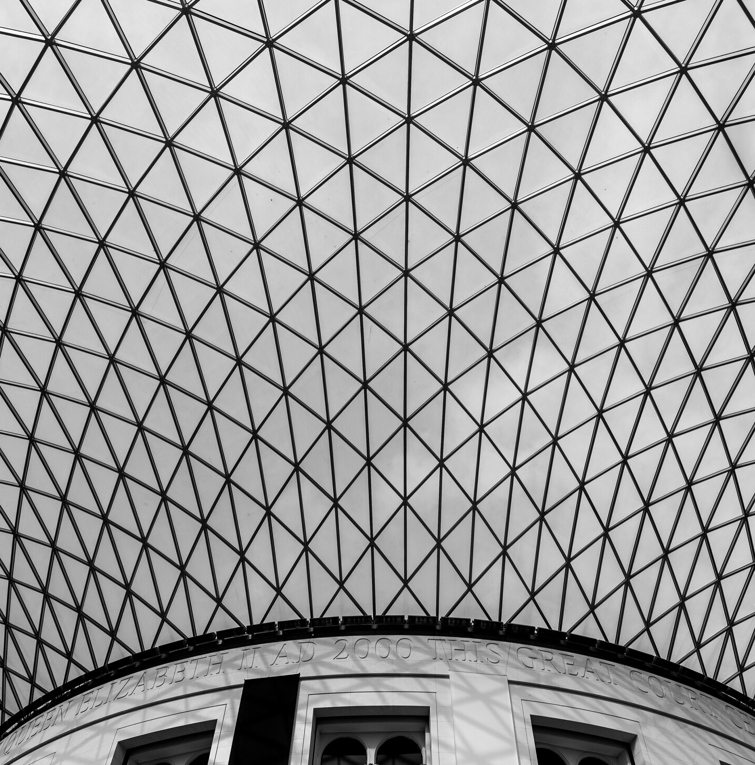
ALISHA PARVEEN
HARSHIT DIXIT
Front End
Documentation
Front End
Documentation
Contributors for the project
SATYAM SETH
Data collection
API
Backend
ANKIT GUPTA
ABHISHEK KUMAR
Data processing
Front End

